Slide 1

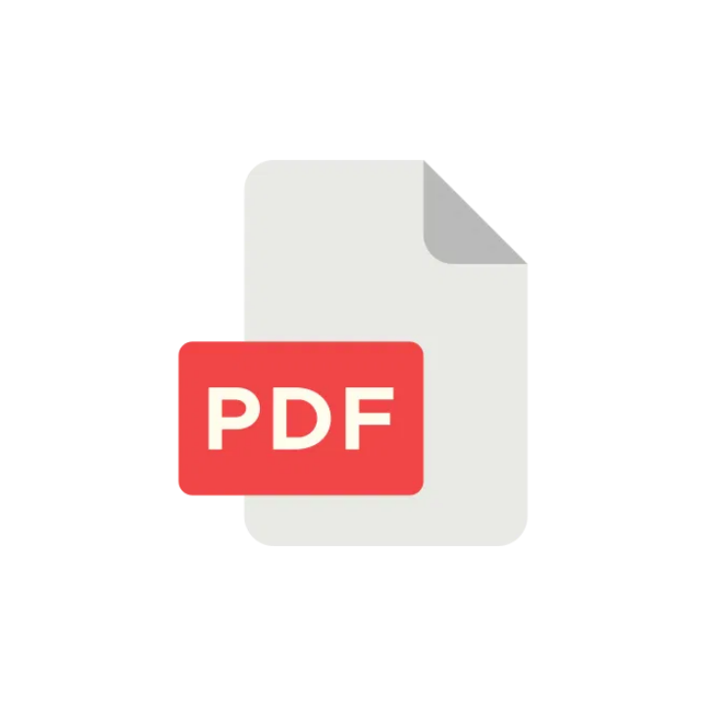
PDF to Markdown:
Streamlining Content
Extraction
A Minimalist Approach to Document Processing

Slide 2

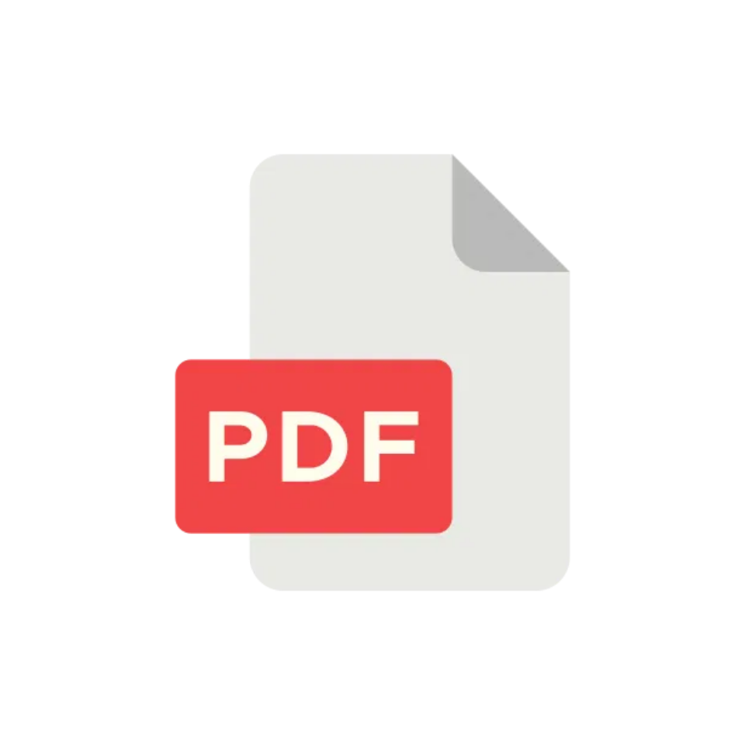
The Data Silo Problem
Fachbuch literature often locked in PDFs, hindering reuse and analysis.
Valuable content becomes isolated, making it difficult to extract and repurpose.

Slide 3

Introducing the PDF to Markdown Converter
An HTML-based tool for seamless PDF upload and content extraction.
Transforms locked content into accessible, reusable Markdown format.

Slide 4

Simple Upload Interface
Users upload PDF files directly through a clean HTML interface.
Drag & drop your PDF file here or click to browse
Designed for simplicity and ease of use, with minimal steps required.
Upload PDF

Slide 5

Intelligent Text & Graphic Extraction
Advanced processing to accurately pull text and identify graphics.
Preserves document structure while separating content elements.

Slide 6
Structured Markdown Output
#
Document Title
##
Chapter 1
Text content from the PDF...
Extracted content saved into a well-
![
Figure 1
]
formatted
export.md
file.
(
figure1.png
)
##
Chapter 2
Preserves text hierarchy, formatting, and references to extracted graphics.
More content...

Slide 7




Why Markdown? Why This Tool?
Accessibility:
Easy to read and edit.
Reusability:
Content ready for web,
documentation, or further analysis.
Efficiency:
Automates a tedious manual
process.

Slide 8




Less is More: Our Design Principles
White Space: Minimum 20% of slide is white space
Single Focus: One key concept per slide
Text Density: Maximum 3 parts of text per slide

Slide 9




What's Next?
Enhanced graphic recognition and extraction
Support for additional output formats
Batch processing capabilities

Slide 10


Try It Out!
Experience seamless PDF content extraction with our minimalist tool.
Transform your locked Fachbuch literature into accessible, reusable Markdown format.
Get Started Now

